Slide 1
Infinite Theft
Reflections on the State of the Art in Musaicing, Plunderphonics and Concatenative Sound Synthesis
Cárthach Ó Nuanáin – Melodrive Inc. / Universitat Pompeu Fabra
carthach@carthach.tk
www.carthach.tk

Slide 2
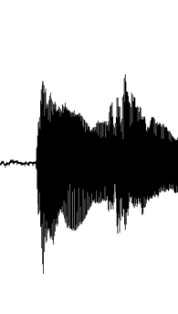
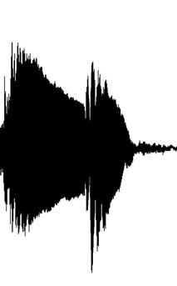
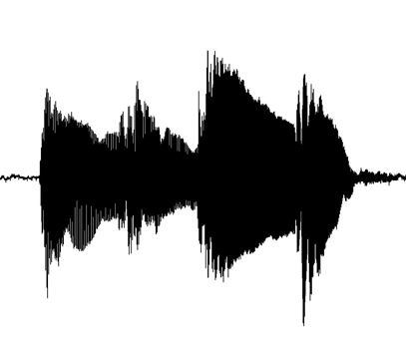
Concatenative Synthesis
Creating new sounds by stitching existing ones together according to some rules and procedures.
https://www.youtube.com/watch?v=6mn5Y2dhB5Q
Related to Granular Synthesis (Roads 2004).
  Larger orders of scale
  Feature and Descriptor Based
  Targetted
+
=

Slide 3
Structure
History and Influences
State of the Art
Theory and Technique
Applications

Slide 4
History and Influences – Cubism and Collage
Guitar, Sheet Music, and Glass (Picasso 1912)

Slide 5
Quotation and Variation in Music
Western Art Music
  Charles Ives – Three Places In New England
    Hymns and marches
  Bartók and Kodály
    Appropriated Hungarian folk melodies
Jazz quotation of other tunes common practice, often for humorous effect
  Charlie Parker quoting the Firebird Suite at a gig in New York, Stravinsky in the audience “[roaring] with delight, pounding his glass on the table”

Slide 6
Musique Concrète
Groupe de Recherche de Musique Concrète (GRM)
  Radiodiffusion-Télévision Française (RTF) Paris, 1940s
  Pierre Schaeffer and Pierre Henry
Sound collages - unrelated and “non-musical” sounds like trains and speech. organised in such a way that the listener discovered the latent musical qualities and structure they inherently carry.

Slide 7
Granular Synthesis of Microsound
Iannis Xenakis also spent time experimenting at tape with the GRM (GRM Works 1957-1962).
But by 1959 was starting to use a profoundly meticulous approach.
Analogique B contains 100s of fragments of recorded sine tones meticulously and laboriously spliced together.
Granular Synthesis – digitally combining many small snippets or grains together to form complex sound clouds (Barry Truax, Curtis Roads).

Slide 8
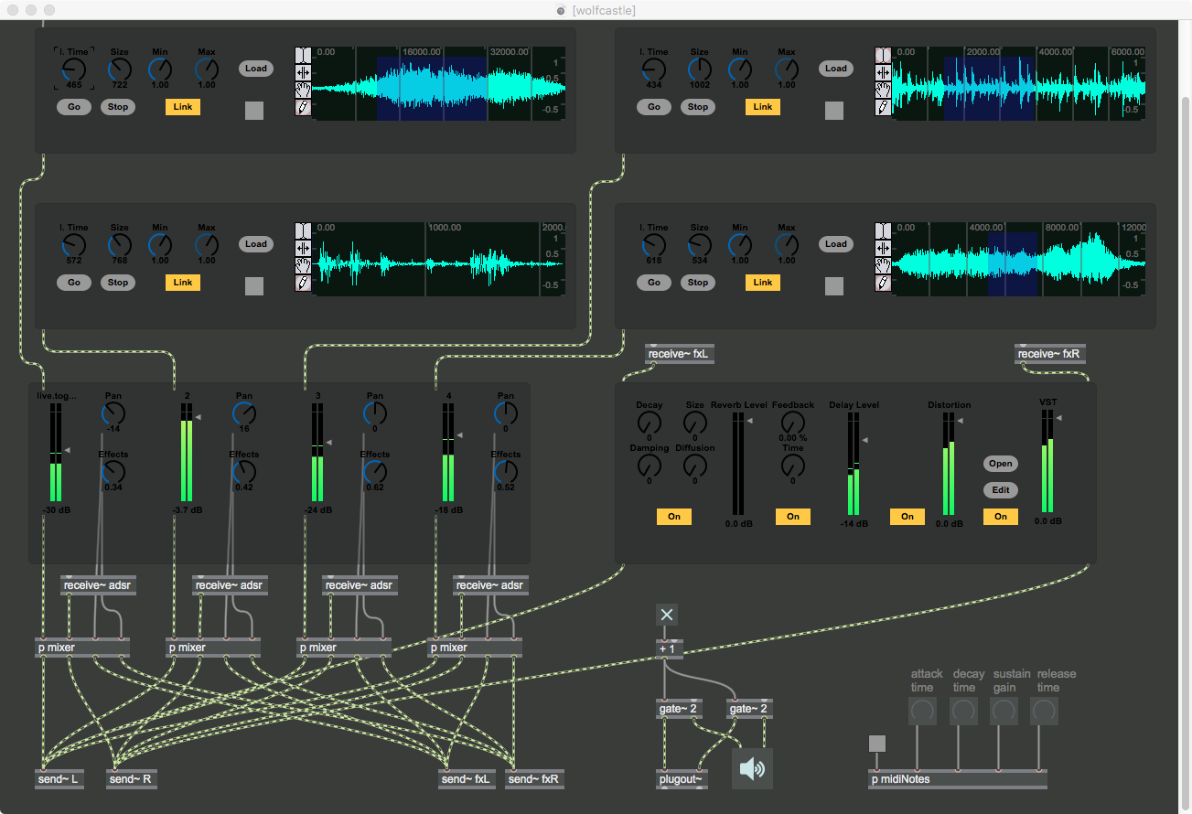
https://soundcloud.com/carthach/the-collapse-of-histrionics

Slide 9
Plunderphonics
Plunderphonics, or Audio Piracy as a Compositional Prerogative (Oswald, 1985)
Plunderphonic (1985)
  Deliberate splicing and transformation of pop recordings (Dolly Parton, Elvis Presley etc.)
  Manual process
  Cease and desist!
https://youtu.be/8xIWLG-F0Ag?t=70

Slide 10
Hip-hop
A sample-centric genre since its inception
  Turntablism
  MPCs & samplers

Slide 11
Structure
History and Influences
State of the Art
Theory and Technique
Applications

Slide 12
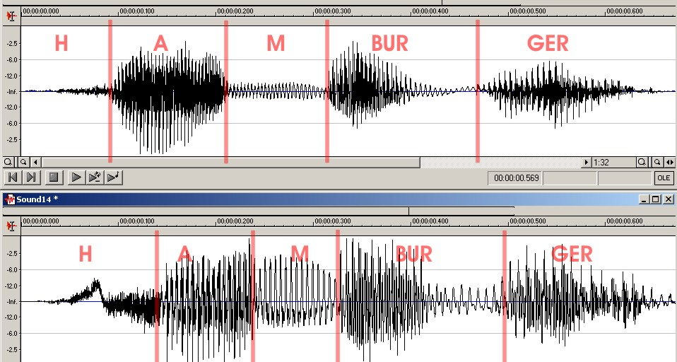
Concatenative Speech Synthesis
Creating natural sounding text to speech via artificial formant synthesis or vocal tract modelling is hard
Concatenative Synthesis
  Large database of recorded phones, diphones syllables etc.
  Unit selection: select from these units of speech and concatenate them to create coherent utterances
  Hunt & Black (1996)

Slide 13
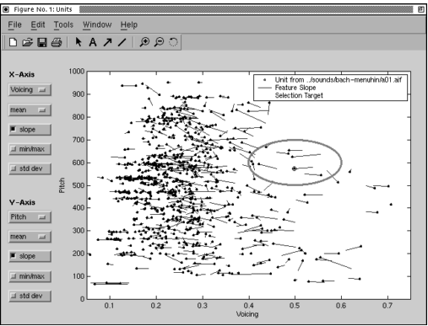
Early Digital Musical Concatenative Synthesis
Caterpillar (Schwarz, 2000)
  Unit Selection Viterbi Algorithm
  (HMMs)
  Constraint Satisfaction
Musaicing (Zils & Pachet 2001)
  Musical Mosaicing
  Constraint Satisfaction
    “Mimic” Mode to model a target
    User selectable constraints

Slide 14
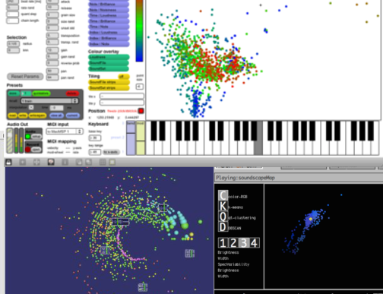
State of The Art – 2D Timbre Spaces
CatArT (Schwarz, 2006) https://youtu.be/cWXdTlu_n44?t=38
AudioGarden (Frisson et al., 2010)
EarGram (Bernardes, 2014)

Slide 15
Structure
History and Influences
State of the Art
Theory and Technique
Applications

Slide 16
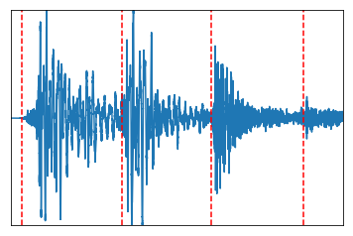
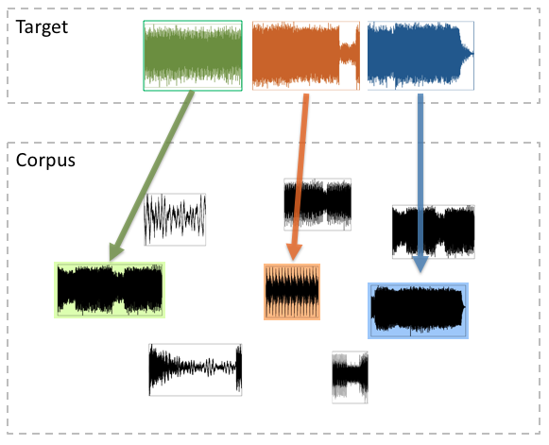
Concatenative Synthesis Stages and Theory
(A)
Unit Decomposition
(B)
Feature Analysis
(C)
Unit Selection
Notes:
Make this a diagram!

Slide 17

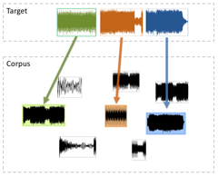
(A) Unit Decomposition
Unit scales:
  Frame-based on some fixed sample size – (in time domain or using FFT/IFFT resynthesis)
  Onsets using some onset detection methods
  Beats with the aid of tempo tracking.
Onset detection seems to be the most dominant (onset ~= note)
Many excellent onset detectors already exist!
  Spectral Flux or Neural Networks

Slide 18
Track – ”My Sound” by Joey Beltram (R&S Records)

Slide 19
(B) Feature Analysis
Unit Decomposition -> segmented, atomic units
Need to analyse the units using descriptors or feature extractors
Feature analysis allows us to select units by comparing their analysed features
Useful Feature Types:
  Temporal (how loud a signal is, how sharp is the attack)
  Spectral (how “bright”, ”dark” “peaky”, or “noisy” a signal is).
  Musical (pitch and chroma)
  Timbral*

Slide 20
Feature Analysis - Timbre
Timbre
  “that attribute of auditory sensation, in terms of which a listener can judge that two sounds similarly presented and having the same loudness and pitch are dissimilar”
  One of the de facto descriptors used for analysing and comparing timbres are the Mel Frequency Cepstral Coefficients (MFCCs).
  Cepstum ~= “Spectrum of a spectrum”
  Can Compute velocity and acceleration also
  Frequency Warping using Mel Scale

Slide 21
Frequency Warping

Slide 22
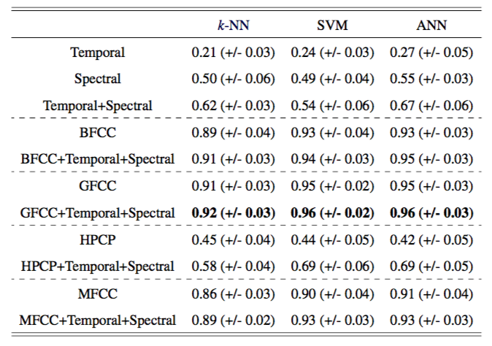
Orchestral Classification Results

Slide 23
(C) Unit Selection
Combine segmented and analysed units together in an intelligent manner – using a target
Various Methods
  Linear Search (using distance/similarity measures)
  Constraint Satisfaction
  Hidden Markov Models / Viterbi

Slide 24
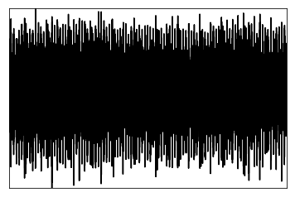
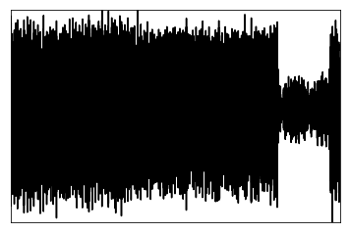
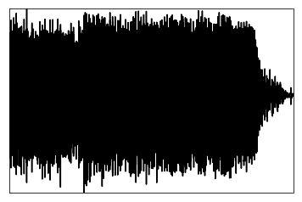
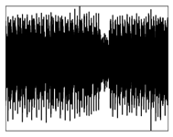
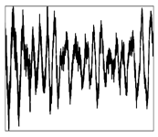
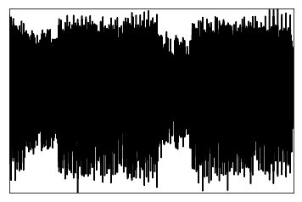
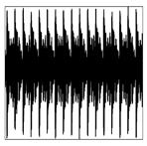
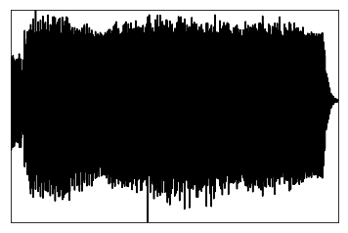
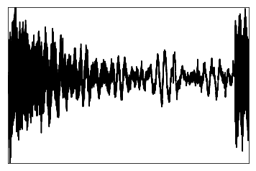
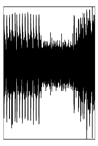
Linear Search
Target
f1 | f2 | … | fN
0.5 | 330.0 | … | 0.2578
Corpus
Target Cost
f1 | f2 | … | fN
0.21 | 440.0 | … | 3.4

Slide 25
Unit Selection – Hidden Markov Model (HMM)
Target
Corpus
Target Cost
Join or Concatenation Cost

Slide 26
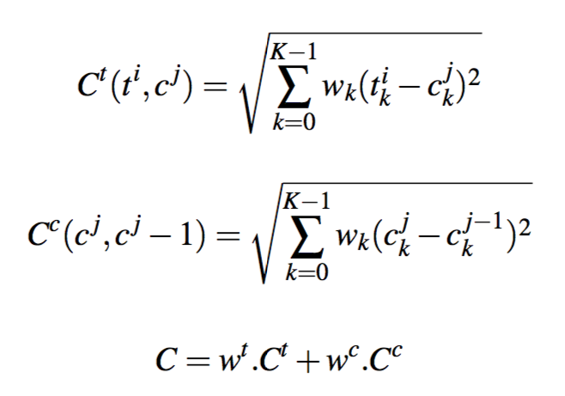
HMMs
Allows minimisation of target and concatenation costs
Concatenation cost to ensure consistency or stability of certain features (e.g. pitch and loudness)
Viterbi algorithm solves this, but produces only one optimal sequence (not ideal for music!)

Slide 27
New Methods
We built a system that can return the top k highest scoring sequences (Ó Nuanáin et al. 2017a 2017b)
But they are very slow (faster algorithms needed)
*https://github.com/carthach/kbestviterbi

Slide 28
Structure
History and Influences
State of the Art
Theory and Technique
Applications

Slide 29
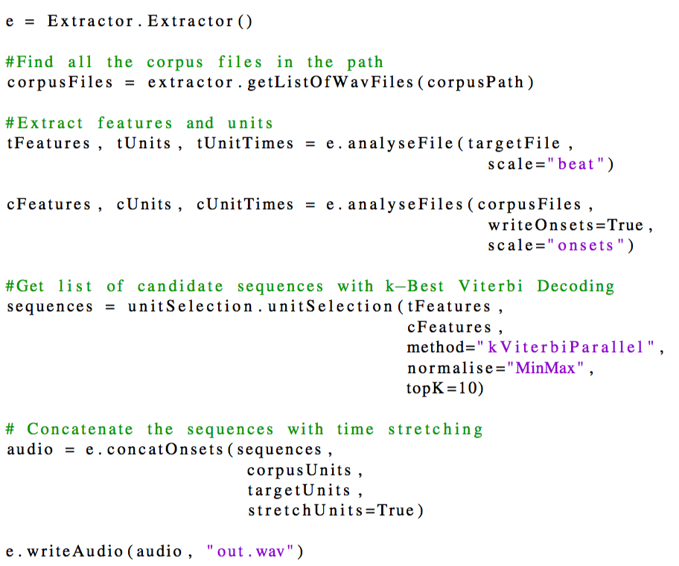
PyConcat - https://github.com/carthach/PyConcat
Python library for conducting research-oriented concatenative synthesis of signals.

Slide 30
RhythmCAT
User friendly (VST support) instrument for generating rhythmic loops (like drum patterns) using concatenative synthesis.
  Best Paper: NIME 2016
  Extended summary and qualitivate quantitative evaluation: Computer Music Journal Summer 2017
Familiar 2D Timbre space interface but with a novel graph-based paradigm for targeting patterns and sequence.

Slide 31
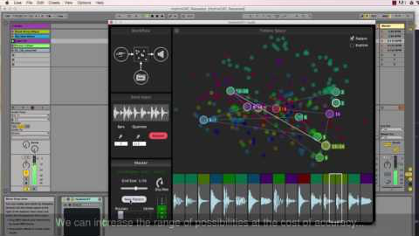
RhythmCAT - Demo

Slide 32
The Snitch (Ó Nuanáin et al. 2015)
Conceived over 24 hours as part of the Music Hack Day at Sónar Festival (2015)
3 month funding for an expanded demo at Music Tech Fest in Slovenia and ISMIR 2015.
Suite of tools:
  Mobile app listening in real-time for Pitch Class Profiles and chroma “key”. Sends OSC information to:
  VST plugin for concatenating and transforming sounds always ”in key”.
  Max for Live MIDI device for choosing notes always “in key”.

Slide 33
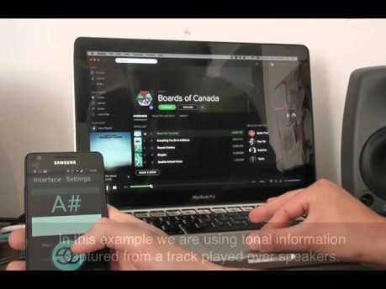
The Snitch - Demo

Slide 34
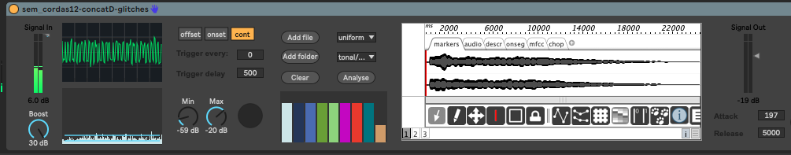
Decon
Concatenative Synthesiser for interacting with musicians in real-time, based on a prior Max for Live device for interacting with a string quartet (Ó Nuanáin, 2017)
Responds to audio input in onset/offset or continuous mode
https://soundcloud.com/carthach/sem-cordas-stereo-demo

Slide 35
Thank you for your time and questions!

