Slide 1
A Quantitative Survey of Digital Competencies of Music Teachers in the European Union
Digital Skills for Music Teachers (DISK)
Cárthach Ó Nuanáin, Esther Viñuela Lozano, Kadri Steinbach, Yvan Corbat, Themuri Sulamanidze, Raquel López and Maria O Connor

Slide 2
Agenda
Introduction and Project Partners
Project Aims
Previous Work
Quantitative Survey Design and Initial Results
Remarks & Next Steps

Slide 3
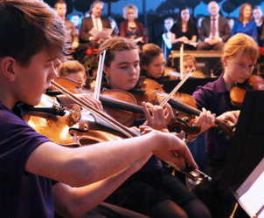


Introduction
Digital Skills 4 Music Teachers (DISK) is a project conceived in 2022 with the aim of contributing to the digitisation of music education in Europe.

Slide 4




Partners

Slide 5
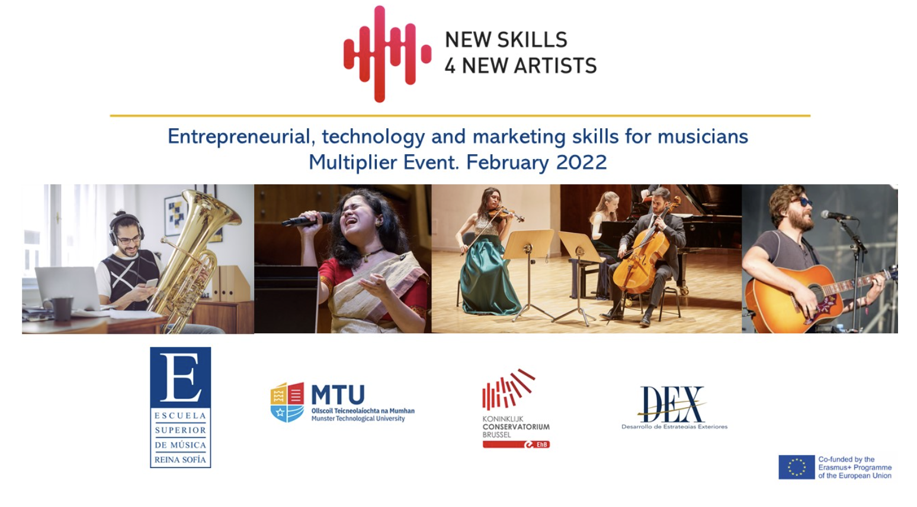
Previous Work – NS4NA
New Skills for New Artists (NS4NA) addressed an identified gap in the training of musicians and similar performers. The aim of the Erasmus+ KA2 funded project was to create training programmes in digital and entrepreneurial skills for new musicians and performers.

Slide 6

DISK - Project Aims
To provide a scientific framework for the development of various strategies for the digitisation of music education.
To design and test a training curriculum in digital competencies for music teachers.
To generate a toolbox for scaling up the digitisation of music education at the European level.

Slide 7
Thematic Areas
Online safety, ethics and rights management
Cybersecurity, bullying, intellectual property and artists’ rights
Collaborating in a teaching environment shaped by new technologies
communication and productivity
Online Music Pedagogy
Audience engagement, methodologies, feedback and assessment
Specific Digital Skills for Music Teachers
audiovisual software and hardware, generative AI, immersive media

Slide 8

WP2 - Content Design Towards a Digital Literacy Framework for Music Teachers
Building evidence towards curriculum design for music teachers based on two main activities:
Benchmarking of existing courses that target music teachers
Mixed-methods survey to understand what digital skills music teachers lack AND the factors that are blocking learning of such skills

Slide 9

Survey Overview
Mixed-methods approach:
Quantitative: MS Forms Survey of ~300 music teachers in the EU
Combination of quantitative Likert scale ratings + open-ended feedback
Qualitative: Semi-structured Interviews
30 selected participants – 10 from each partner region
Descriptive and Inferential Statistics
Thematic Analysis
Zoom/Teams Auto Transcriptions, Auto Translate with Manual Corrections

Slide 10
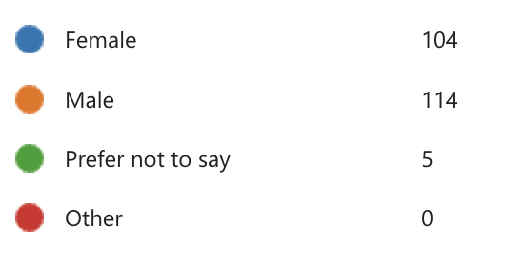
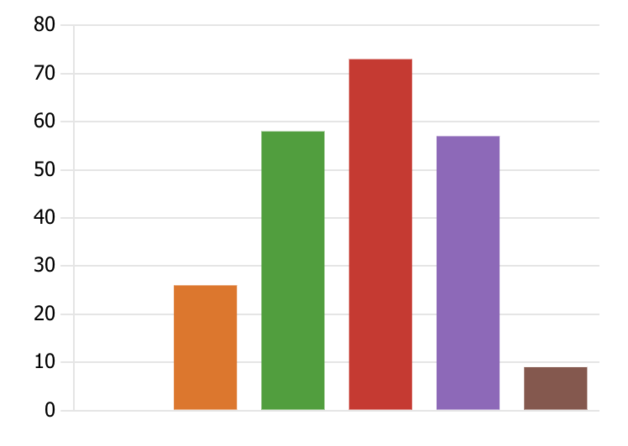
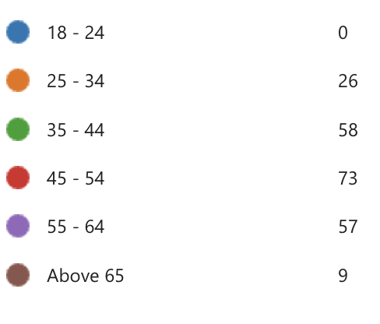
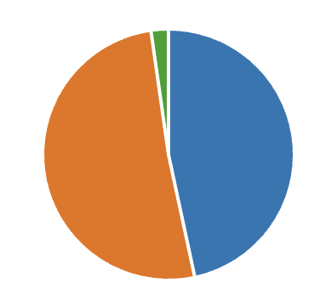
Age & Gender

Slide 11
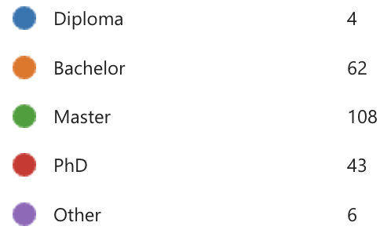
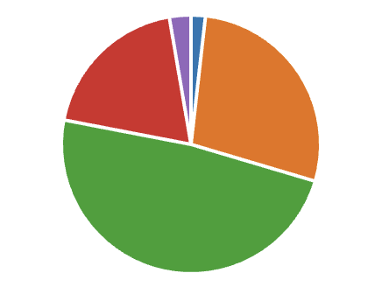
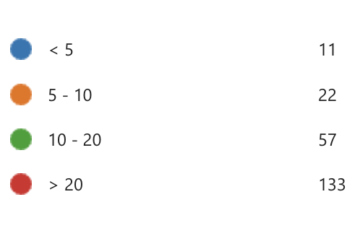
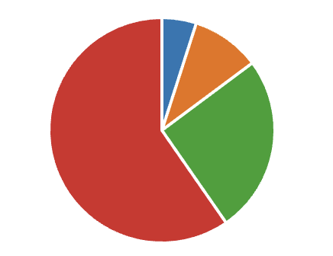
Teaching Experience
Highest Qualification
Attained
Years Teaching

Slide 12
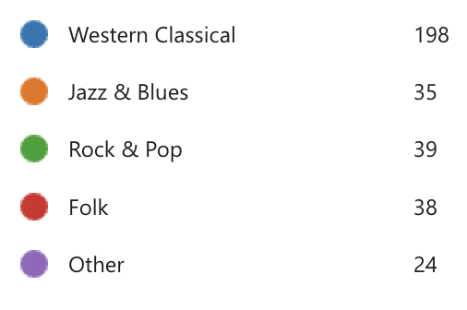
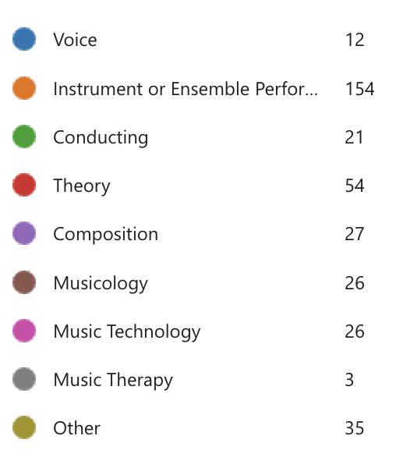
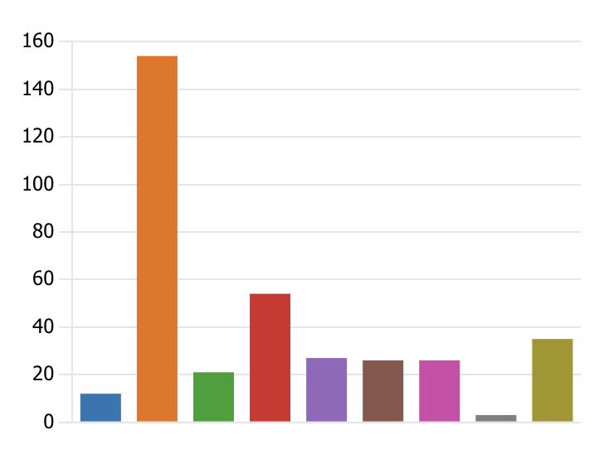
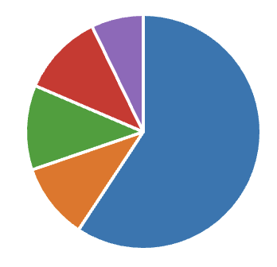
Style and Specialisation

Slide 13
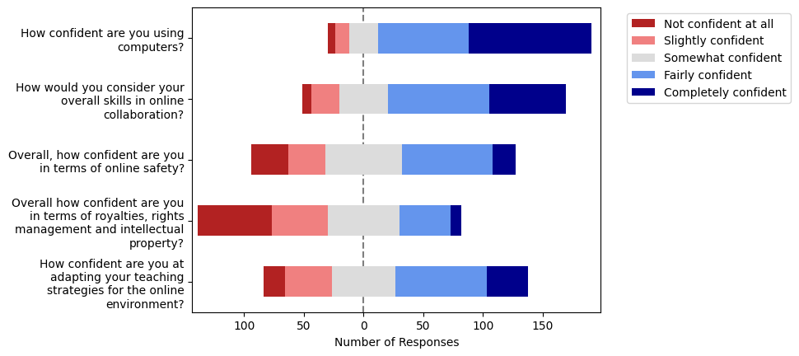
General Confidence Ratings

Slide 14
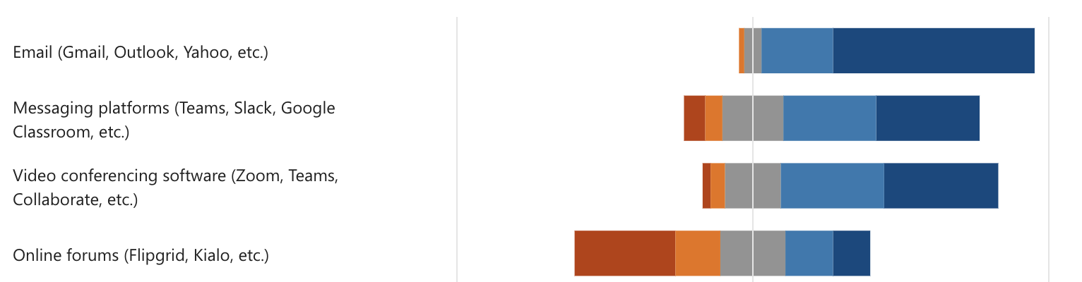
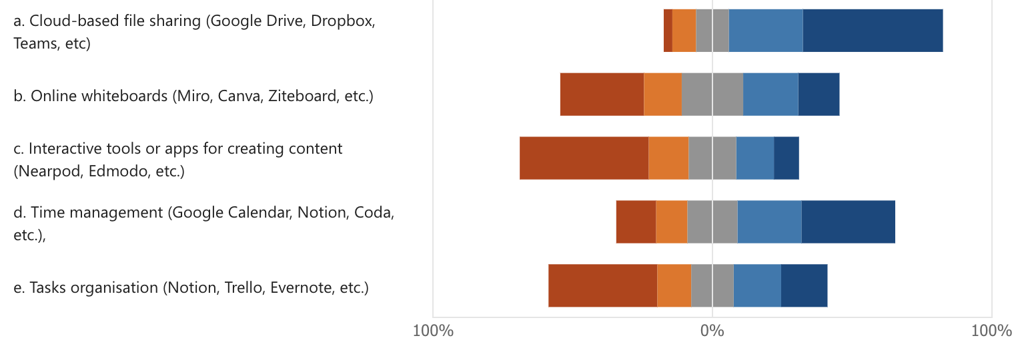
Online Collaboration
Communication
Productivity

Slide 15
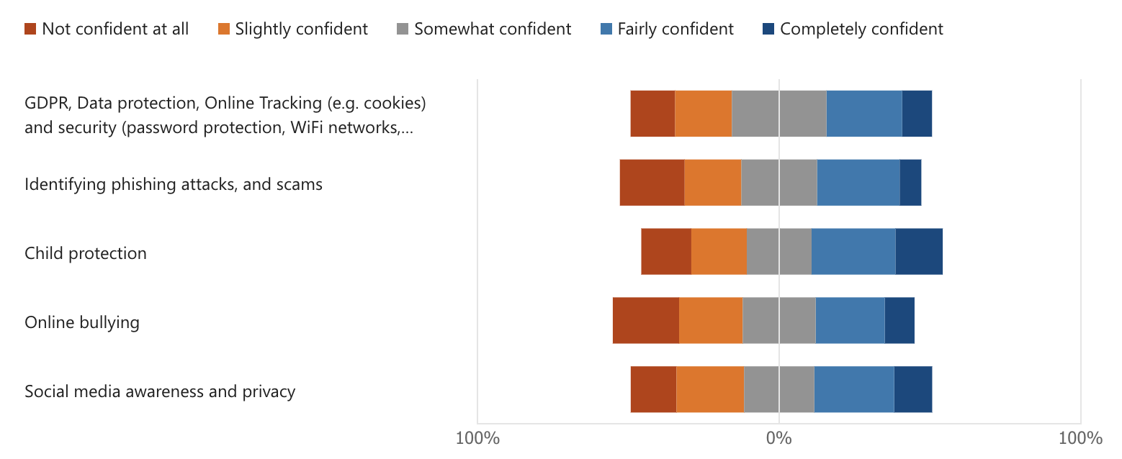
Online Safety

Slide 16
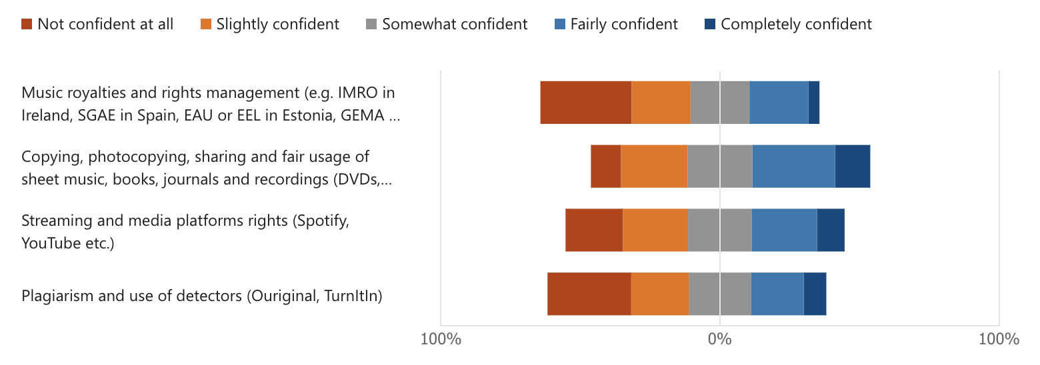
Royalties, Rights and IP

Slide 17
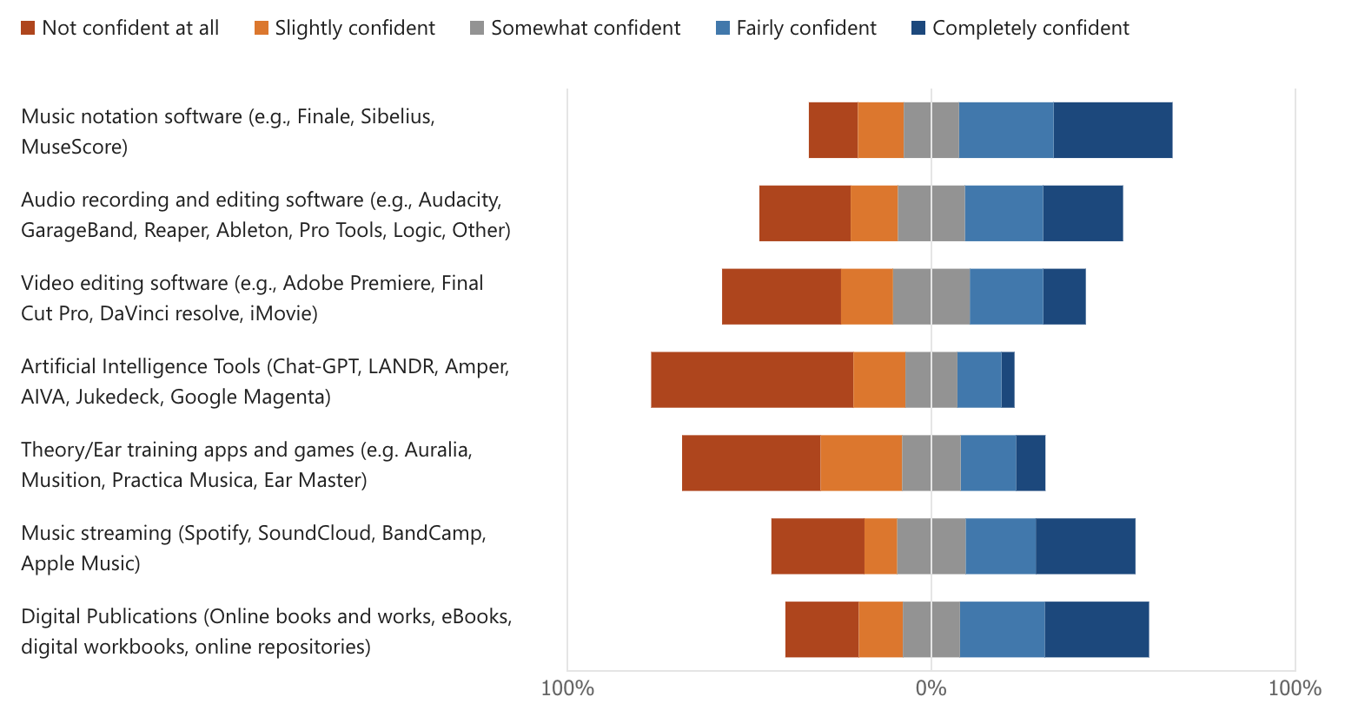
Digital Tools for Music Education

Slide 18
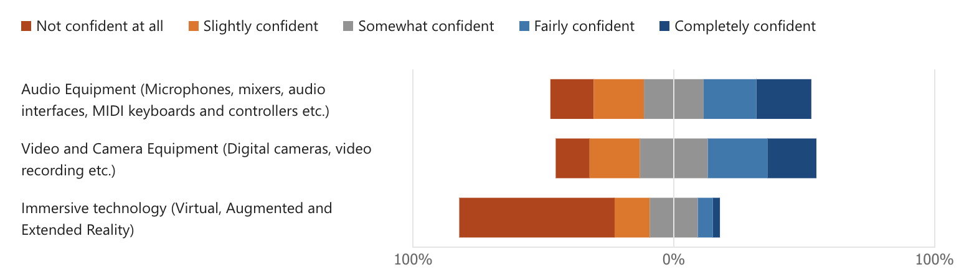
Hardware Tools for Music Education

Slide 19
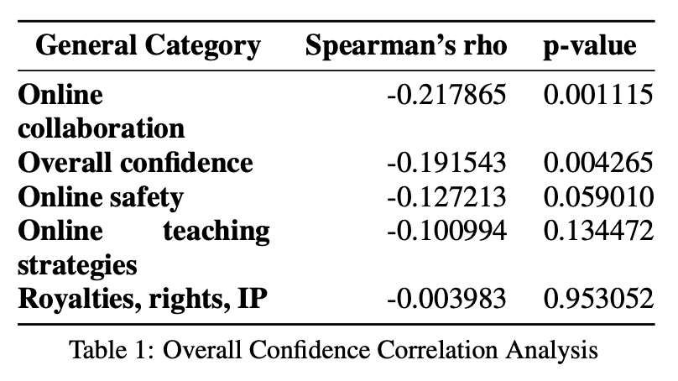
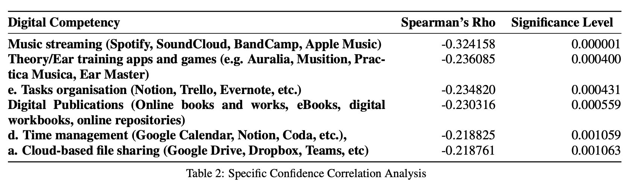
Effect of Age
Hypothesis Testing Approach 1
Method:
  Compute Spearman’s Correlation between Age and Overall confidence levels
  Compute Spearman’s Correlation between Age and specific confidence levels

Slide 20
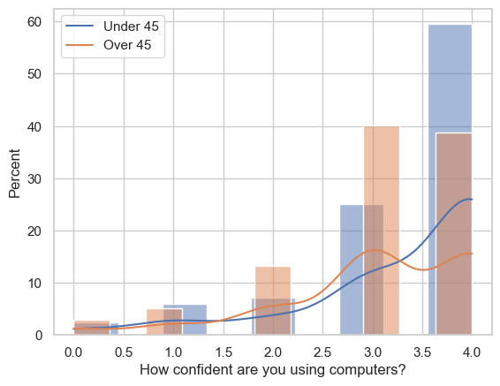
Effect of Age
Hypothesis Testing Approach 2
Method:
  Separate Under 45s from Over 45s and look at median Overall Confidence
  Compute Mann-Whitney U test to establish groups are different
Result:
  Under 45s Median: 4.0
  Over 45s Median: 3.0
  statistic=5854.0
  pvalue<0.05

Slide 21
Main Takeaways
Teachers consider them broadly confident in their digital skills
…but lack knowledge around copyright, ethics, online safety
Specialised tools are underutilised for music education (e.g. games, apps etc.)
AI is coming but are they ready?
Next Steps: Qualitative Survey

Slide 22
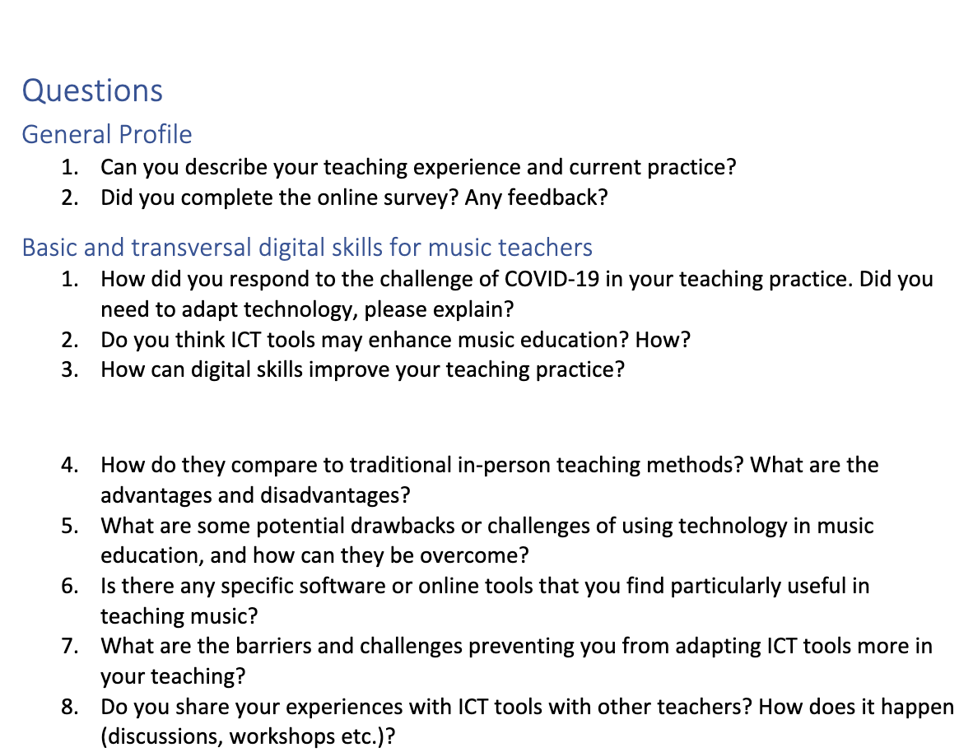
Qualitative:
Sample Questions

Slide 23
Example Personas
“Composer and Performer with a specialism in Experimental Music”
Teaching at 3rd level since 2015 in UK and Ireland
Beginning with group devising classes in improvisation
Currently teaching composition at BA and Master’s
Also some music history and inclusive music making
“Viola teacher and conductor of community youth orchestras”
40 years in conservatoire
Teaching diploma in music
Master’s in conducting
Suzuki method

Slide 24
Example Code Hierarchy
Pedagogical Skills for music teachers in the online context | Methodologies | Gamification and visually reinforced learning can adapt well to online scenarios | “There were some fantastic games on external websites, such as one where you matched sounds. It had a grid with many cells, and you had to uncover them to find pairs of sounds, similar to a memory game but with sound pairs.” In the end, I programmed both the memory game and the Simon game using Scratch. Now they are mine, downloaded, and won't disappear. You can find them on aulamusical.es." "Scratch is a programming tool that teaches programming through blocks. You design directly as a computer programmer, but with pre-made content blocks, even though you may need to write the code yourself. You can program exercises for whatever you want." "work out games that you can do. If you're doing developing ear, you can actually go, and we called it hide and Seek, in which I went off screen played 2 notes, and you come back on screen again. And the kids [pguess the notes]."

Slide 25
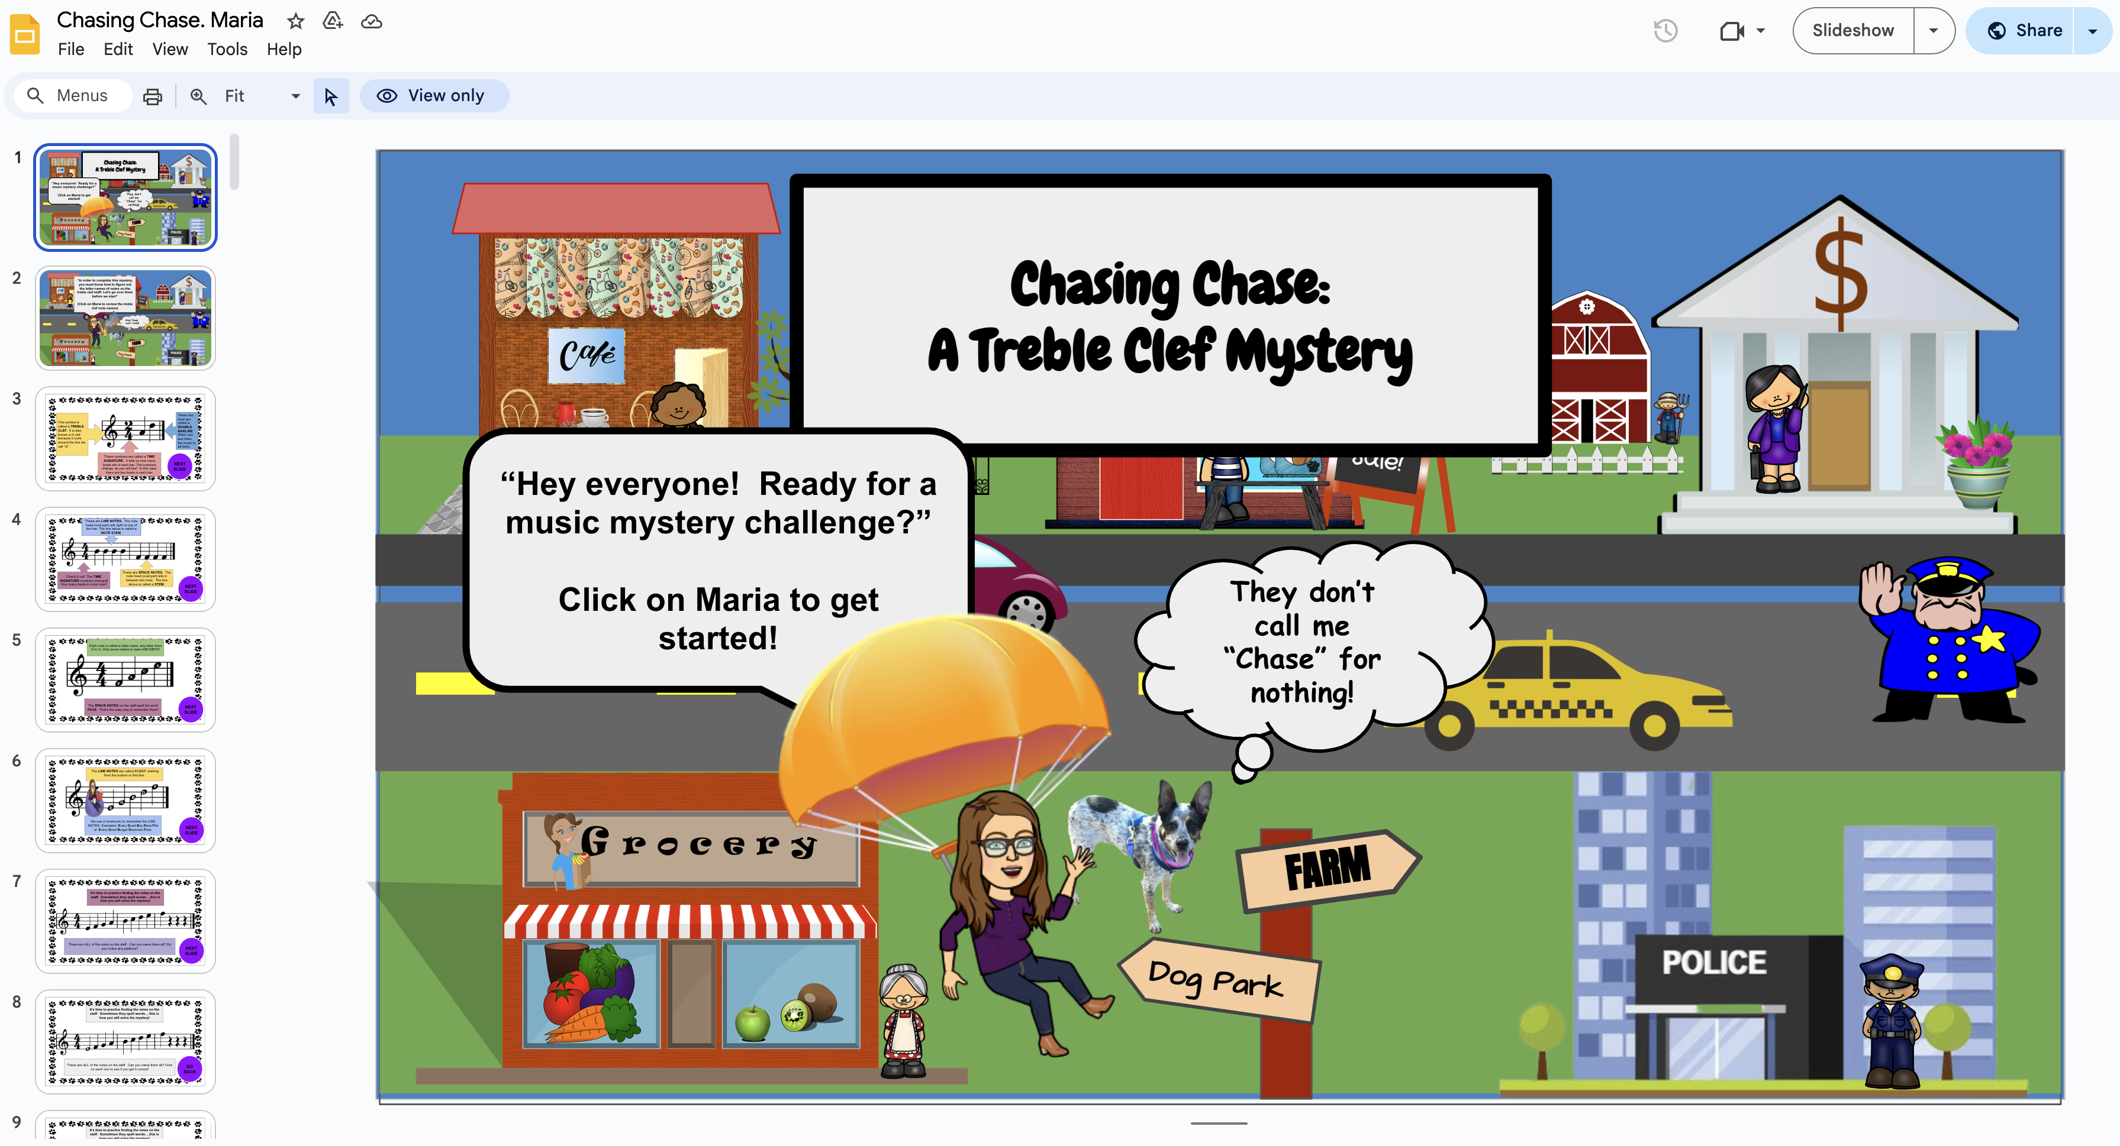

Slide 26
Pilot Curriculum
Runs from March 13th until 3rd of July
35 music teachers from 7 EU countries participating
Moodle centred course hosted and validated by UT
First course will be evaluated and refined for second course in Autumn 2024
More info and syllabus:
  https://digitalskills4musicteachers.eu/en_GB/training

Slide 27
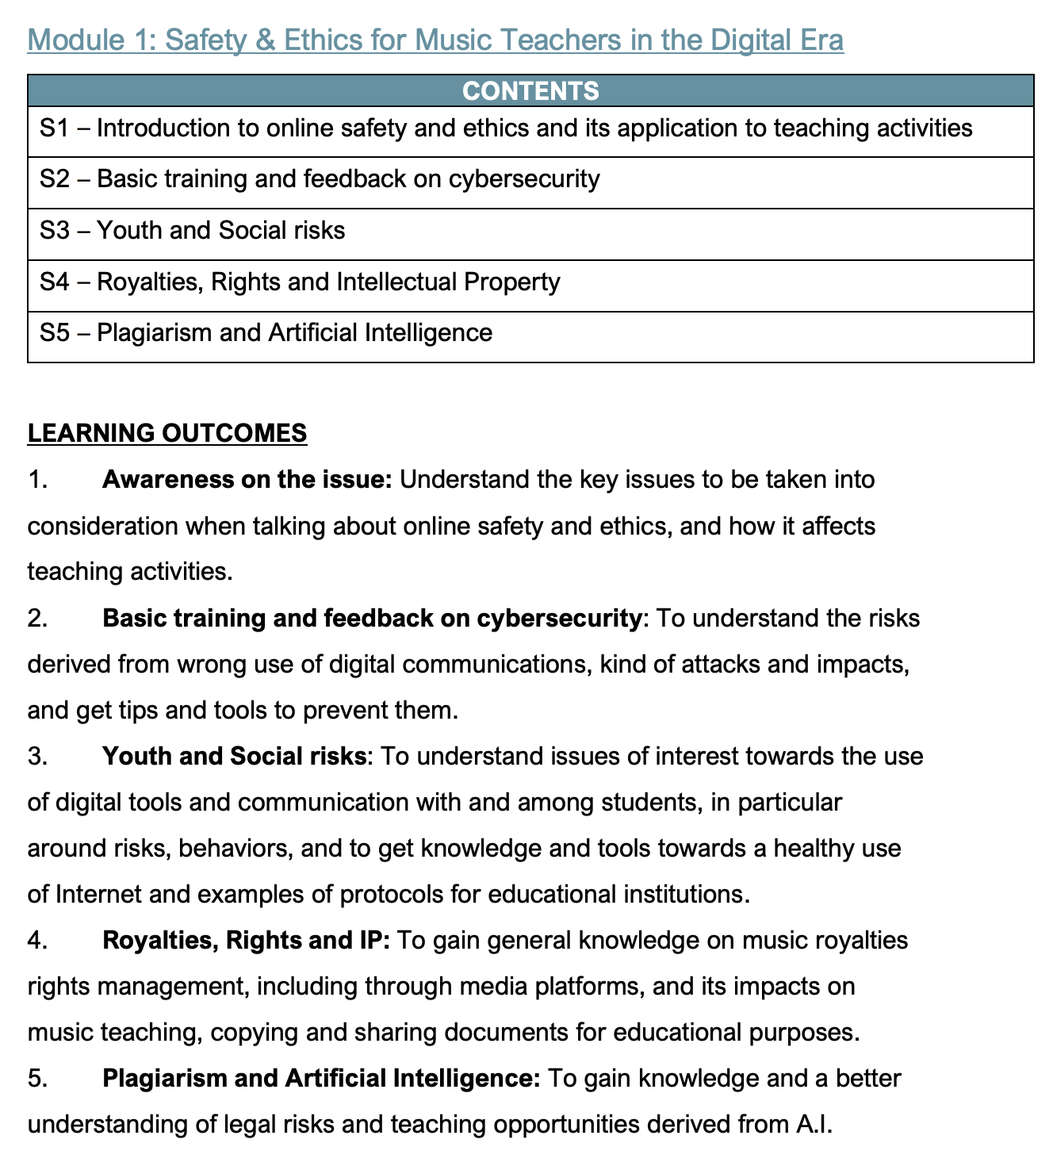
In Progress…

Slide 28
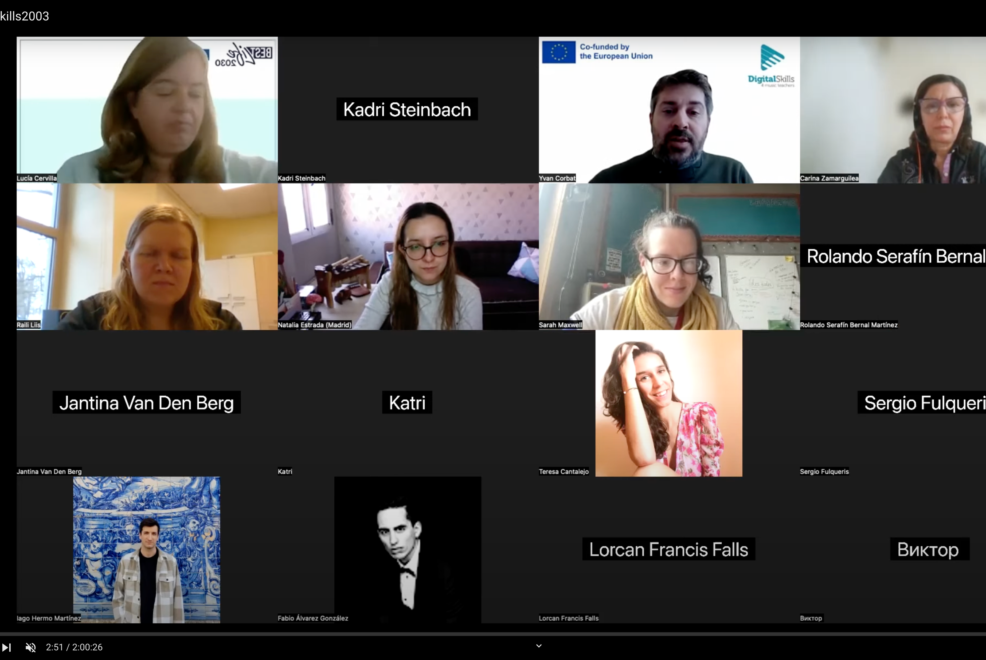
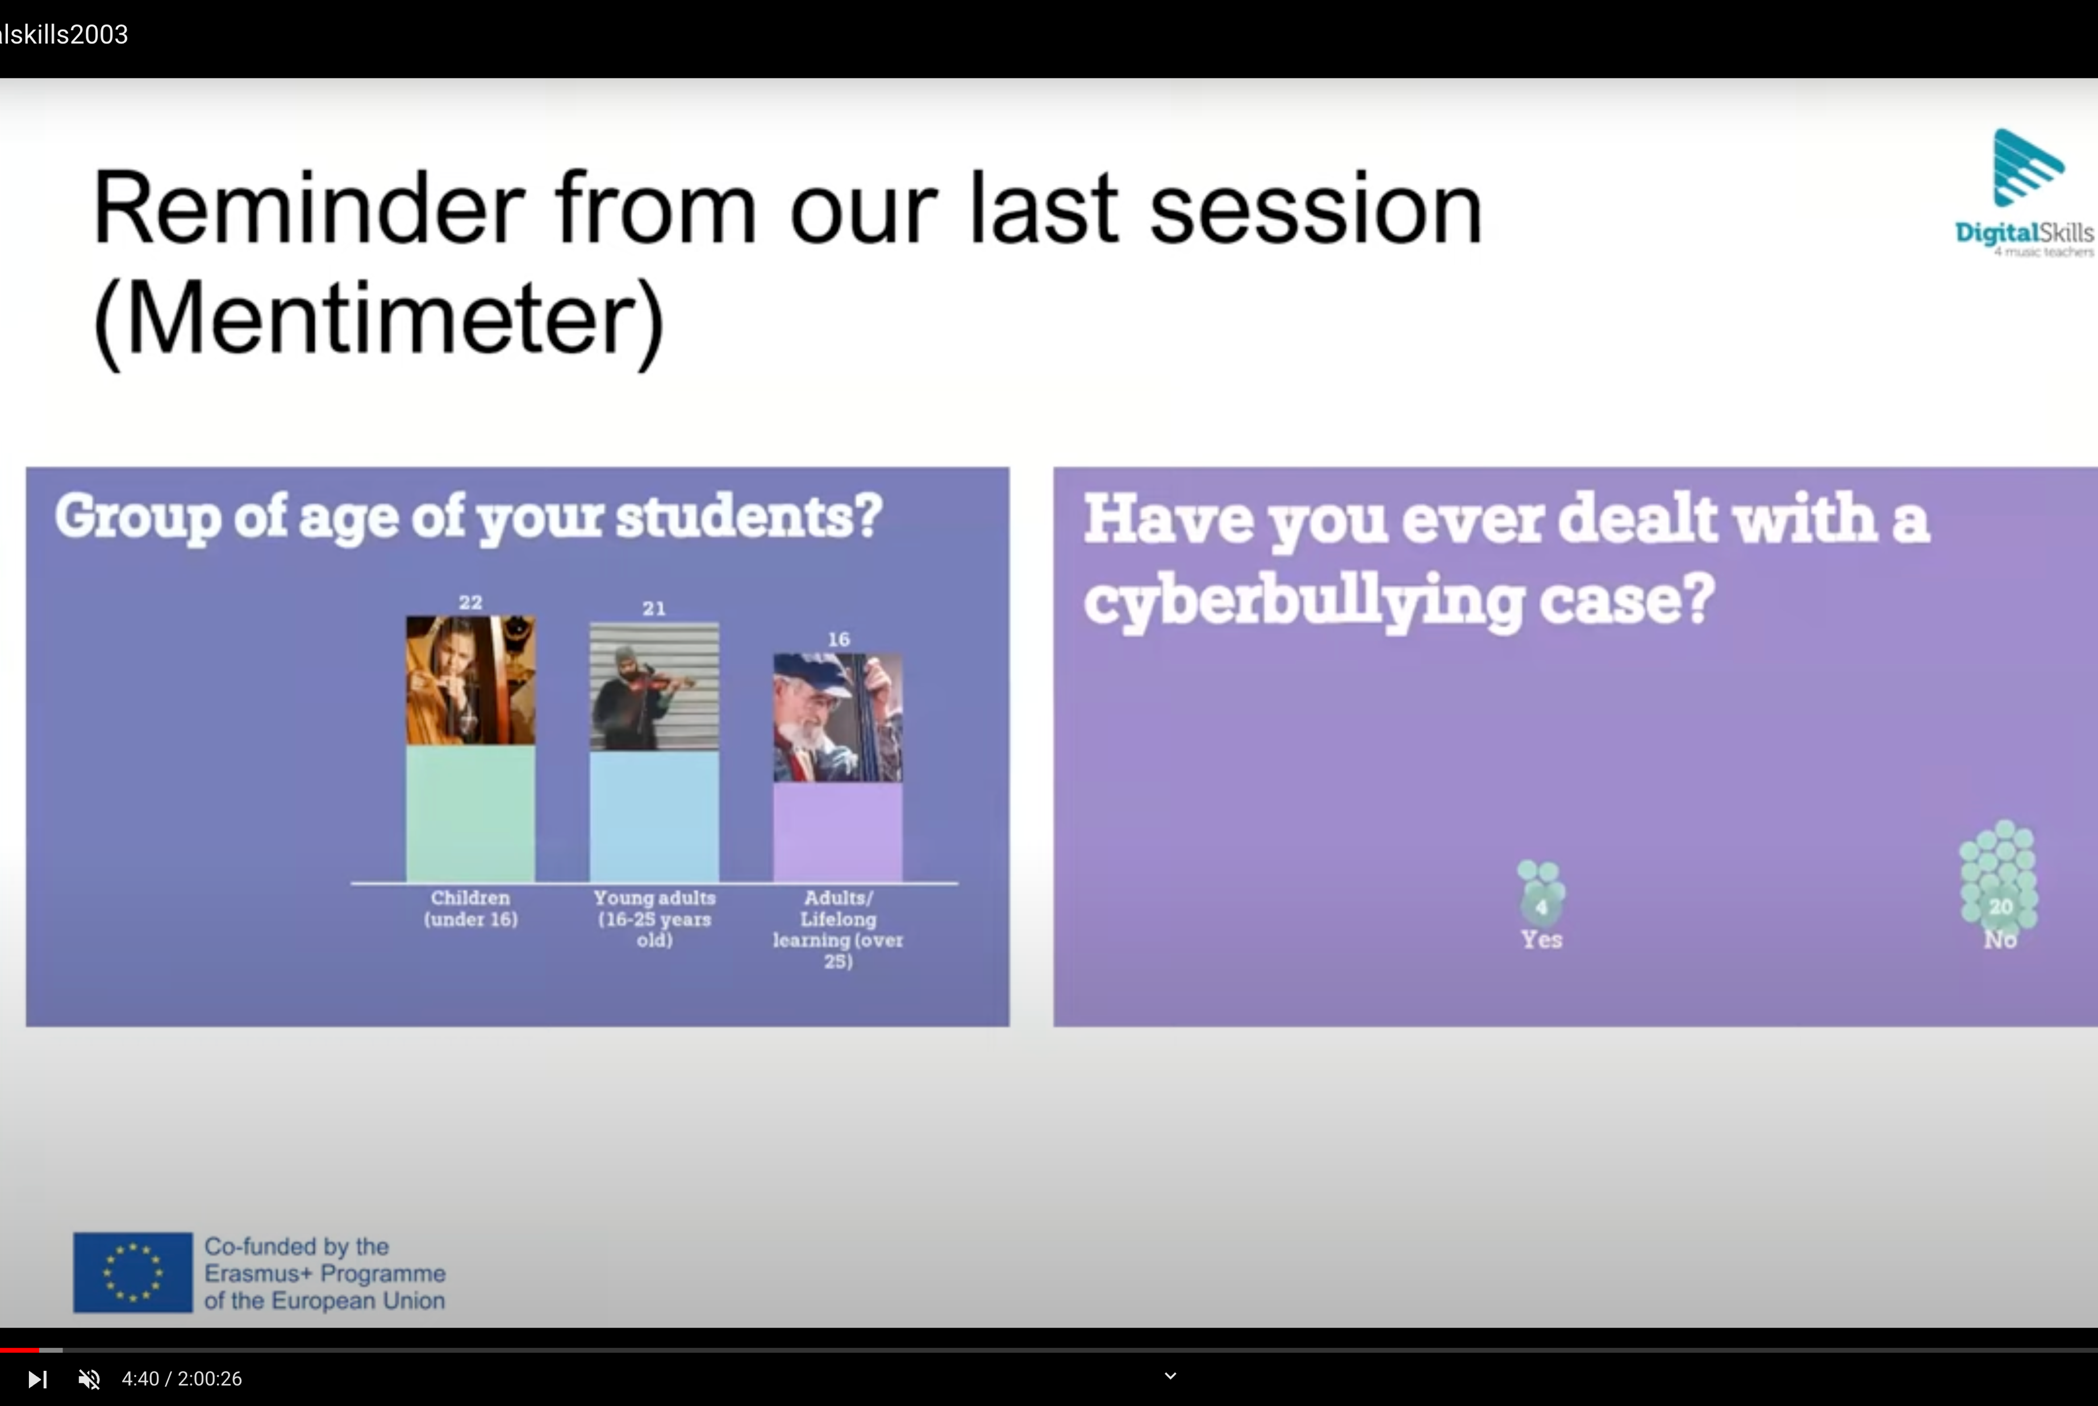

Slide 29
Thank you!
https://digitalskills4musicteachers.eu/
info@digitalskills4newteachers.eu

